Slide 1
Marketing Analysis for Bank
Group 4:
Mohit Shukla (https://github.com/mshukla20/Bank_Marketing)
Shamali Shah (https://github.com/shamali18/Bank_Marketing)
Deepal Rathod (https://github.com/deepalrathod/Bank_Marketing-MVA)

Slide 2
Overview
The data set contains information about a marketing campaign of a financial institution. Purpose of the repository is to analyze the Data set and find insights which will help improve the marketing strategies.
Find the best strategies to improve for the next marketing campaign. How can the financial institution have a greater effectiveness for future marketing campaigns? In order to answer this, we have to analyze the last marketing campaign the bank performed and identify the patterns that will help us find conclusions in order to develop future strategies.

Slide 3
Problem Statement
1) We consider the situation of a financial institution where business is directly proportional to the amount of deposits (customers) who invest in it.
2) To get more clients to deposit and subscribe, they use the best techniques for marketing, a good approach towards a target audience would help this.
3) The Dataset, contains all the data of the previous subscribers. By using appropriate Data Analysis techniques, we can obtain and conclude and target specific group of customers who will subscribe, which will further help us find conclusions in order to develop further strategies.
4) To analyze which group of customers agreed to subscribe the most
5) To analyze which group of customers did not subscribe to deposit
6) To find out if low balance, or age or any other reason for the customer disagreement to not subscribe

Slide 4
Sample Dataset
The marketing bank dataset gives information about a marketing campaign of a financial institution in which we will analyze ways to look for future strategies in order to improve future marketing campaigns for the bank.
age | job | marital | education | default | balance | housing | loan | contact | day | month | duration | campaign | pdays | previous | poutcome | deposit
59 | admin. | married | secondary | no | 2343 | yes | no | unknown | 5 | may | 1042 | 1 | -1 | 0 | unknown | yes
56 | admin. | married | secondary | no | 45 | no | no | unknown | 5 | may | 1467 | 1 | -1 | 0 | unknown | yes
41 | technician | married | secondary | no | 1270 | yes | no | unknown | 5 | may | 1389 | 1 | -1 | 0 | unknown | yes
55 | services | married | secondary | no | 2476 | yes | no | unknown | 5 | may | 579 | 1 | -1 | 0 | unknown | yes
54 | admin. | married | tertiary | no | 184 | no | no | unknown | 5 | may | 673 | 2 | -1 | 0 | unknown | yes
42 | management | single | tertiary | no | 0 | yes | yes | unknown | 5 | may | 562 | 2 | -1 | 0 | unknown | yes
56 | management | married | tertiary | no | 830 | yes | yes | unknown | 6 | may | 1201 | 1 | -1 | 0 | unknown | yes
60 | retired | divorced | secondary | no | 545 | yes | no | unknown | 6 | may | 1030 | 1 | -1 | 0 | unknown | yes
37 | technician | married | secondary | no | 1 | yes | no | unknown | 6 | may | 608 | 1 | -1 | 0 | unknown | yes
28 | services | single | secondary | no | 5090 | yes | no | unknown | 6 | may | 1297 | 3 | -1 | 0 | unknown | yes

Slide 5
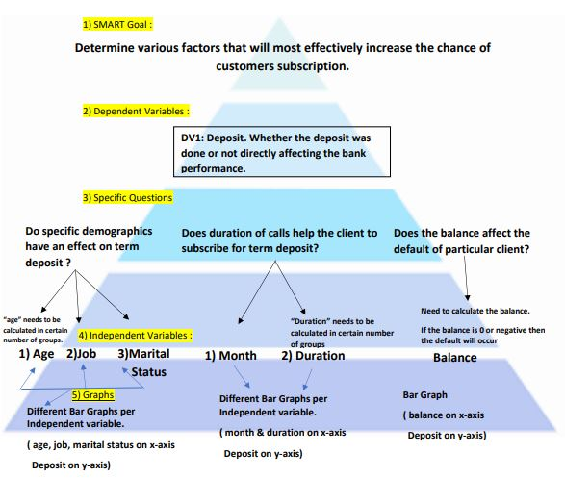
Structured Pyramid Analysis Plan
Hypothesis:
We can use chi-square method to accept or reject the hypothesis.
1) Does the balance affect default occurrence of the particular client?
H0 : Balance doesn’t affect default occurrence of the particular client.
H1 : Balance affects default occurrence of the particular client.
2) Does the marital status have effect on term deposit?
H0: Marital status doesn’t have any effect on term deposit
H1 : Marital status has effect of term deposit.
3) Do the subscriptions increase due to duration of calls?
H0: Subscriptions doesn’t increase due to duration of calls
H1: Subscriptions increase due to duration of calls.

Slide 6
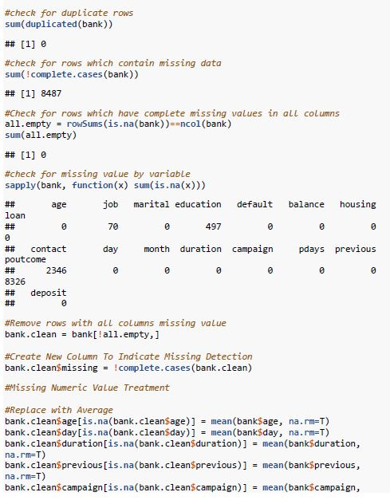
Data Cleaning
Library used:
library(data.table)
library(tidyverse) # data manipulation
library(data.table) # fast file reading
library(gridExtra) # arranging ggplot in grid
library(rmarkdown)
library(tinytex)
library(latexpdf)
library(latex2exp)

Slide 7
Exploratory Data Analysis

Slide 8
Exploratory Data Analysis

Slide 9
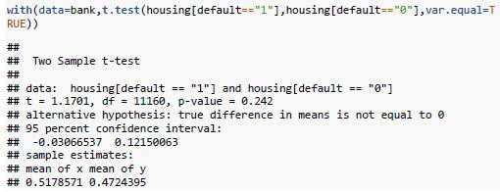
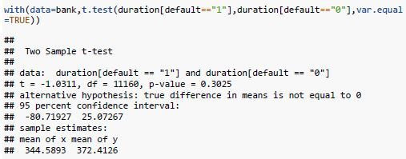
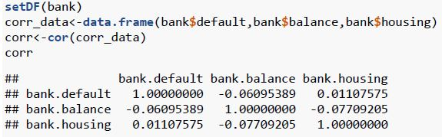
Test Performed – T test, Correlation

Slide 10
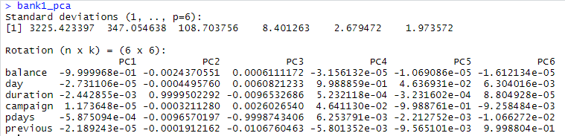

PCA
Using prcomp to compute the principal components (eigenvalues and eigenvectors).
With scale=TRUE, variable means are set to zero, and variances set to one

Slide 11
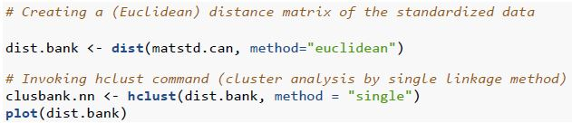
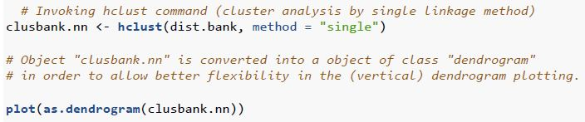
Cluster Analysis

Slide 12

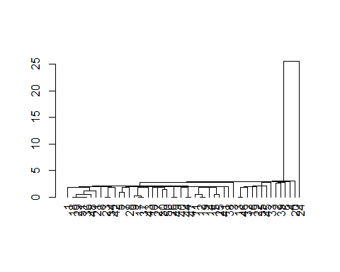
Cluster Analysis

Slide 13
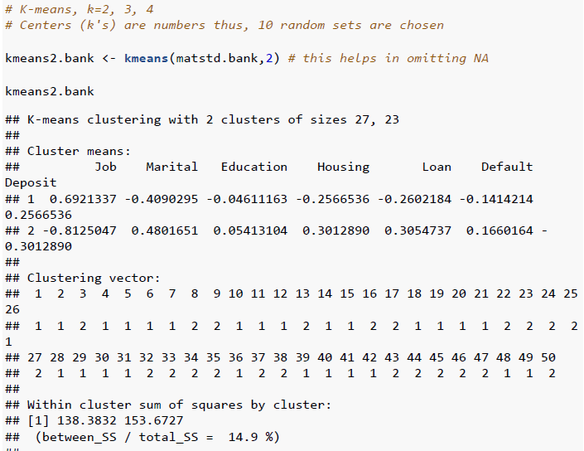
Cluster Analysis
K‐Means Clustering:
The purpose of clustering analysis is to identify patterns in your data and create groups according to those patterns. Therefore, if two points have similar characteristics, that means they have the same pattern and consequently, they belong to the same group. By doing clustering analysis we should be able to check what features usually appear together and see what characterizes a group.

